Slide 1
Compute at the Fog and Edge
Ed Kuzemchak
CTO – Software Design Solutions

Slide 2
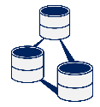





Cloud, Fog, and Edge
Challenges at each layer
Latency
Compute
Power
Context
Comms
Reliability
Environ-
mental
Message
Broker
Analytics
Cloud
Storage
ML
On-Property
Local Compute
On-Machine
Sensing
Processing
Automation
Notes:
Let’s take a look at the standard 3-layer IoT system with Cloud, on property (or Fog) processing, and on-machine (or Edge) processing. Then let’s consider some of the attributes here and talk about the strengths/weaknesses of each layer with respect to that attribute:
Latency – the time it takes from when something (like a pressure) changes, and when you can act on that change
Compute Power – the ability to apply a lot of compute horsepower (with the associate power, cost, size restrictions)
Context – the amount of data (from other sensors, from history, etc) that is available for a making decisions
Comms Reliability – the guarantee that communications will go through uninterrupted
Environmental – the type of environment (temp, moisture, vibration) to which the compute equipment will be subjected
See how the middle layer is often the ‘sweet spot’ for processing, with a good compromise on all the attributes.

Slide 3

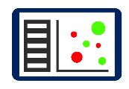



Compute at the Fog and Edge
Message
Broker
Analytics
Cloud
Storage
ML
Maintenance
Dashboards
On-Property
Local Compute
Rules
Update
Local Control
Local ML
Pattern
Matching
Filtering
Image
Processing
On-Machine
Local Fast-loop Control
Sensing
Processing
Automation
Notes:
So how do you take advantage of this sweet spot, where you have enough context, plenty of compute power, and low latency?
You begin by segmenting some of the heavy lifting from the cloud down to this middle layer. For example, once a ML algorithm is trained, a portion of it can run on the gateway, reducing the amount of data that has to be sent to the cloud. In addition, the gateway is a great place to do pattern matching, image processing, and data filtering. All of these are meant to do 2 things:
Reduce the flood of data that is being sent to the cloud down to a stream of useful results that the cloud (with its greater context) can use wisely
Improve the local fast loop control that systems have done for decades with this additional information.
Example: raw data (e.g. temp read 1/sec) = 86K readings/day

Slide 4
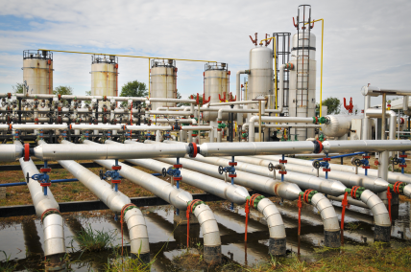
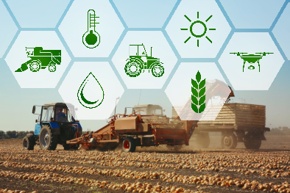
Edge Node Challenges
Cloud
Fog
10s, 100s devices
Edge
10³ – 10⁵ or more devices
Number of devices
Cost constraints
Security
Accessibility (OTA update)
Tight Integration
Part of existing fast-loop control
Multi-vendor compatibility
Long equipment lifetimes
Environmental
Harsh environment
Battery power
Communication availability
Notes:
Let’s take another look at some of the specific challenges for edge nodes:
Number:
Cost constraints come into play when edge nodes number in the tens or hundreds of thousands
Security (and security updates) are a factor. Edge nodes cannot be ‘field and forget’, however, updating thousands of devices with OTA update can be a challenge
Tight Integration:
The same edge nodes in IoT are already in use in fast loop control (e.g. SCADA systems)
The edge nodes must have multi-vendor compatibility and use industry standard communications channels to work with multiple vendor control systems
Industrial equipment has often decades long lifespan
Environmental:
Harsh environment (rain, heat, vibration, radio interference, metal)
Battery operated is the norm
Communications availability may be a challenge

Slide 5
Summary
Edge nodes have unique challenges in IIoT
To achieve compute at the Fog and Edge
  Take advantage of the edge’s proximity to data
  Split up work like ML to Cloud, Fog, and Edge components
  Use reference architectures (OpenFog) as a guide
Notes:
Summary

